Slide 1

Chapter 9
Building a New-Venture Team
Bruce R. Barringer
R. Duane Ireland
Copyright ©2016 Pearson Education, Inc.
9-<number>

Slide 2
Chapter Objectives
Explain the concept called liabilities of newness.
Describe a new-venture team and discuss the primary elements that form such a team.
Identify professional advisers and explain their role with a new-venture team.
Explain why a new-venture team might use consultants to obtain advice.
Copyright ©2016 Pearson Education, Inc.
9-<number>

Slide 3
New-Venture Team
New-Venture Team
  Is the group of founders, key employees, and advisors that move a new venture from an idea to a fully functioning firm.
  Usually, the team doesn’t come together all at once. Instead, it is built as the new firm can afford to hire additional personnel.
  The team also involves more than paid employees.
    Many firms have boards of directors, boards of advisors, and professionals on whom they rely for direction and advice.
Copyright ©2016 Pearson Education, Inc.
9-<number>

Slide 4
Liability of Newness
New ventures have a high propensity to
fail.
The high failure rate is due in part to
liabilities of newness, which refers to the
fact that new companies often falter
because the people involved can’t adjust
fast enough to their new roles and because
the firm lacks a track record of success.
Assembling a talented and experienced
management team is one path that firms
can take to overcome these limitations.
Liability of Newness
Copyright ©2016 Pearson Education, Inc.
9-<number>

Slide 5
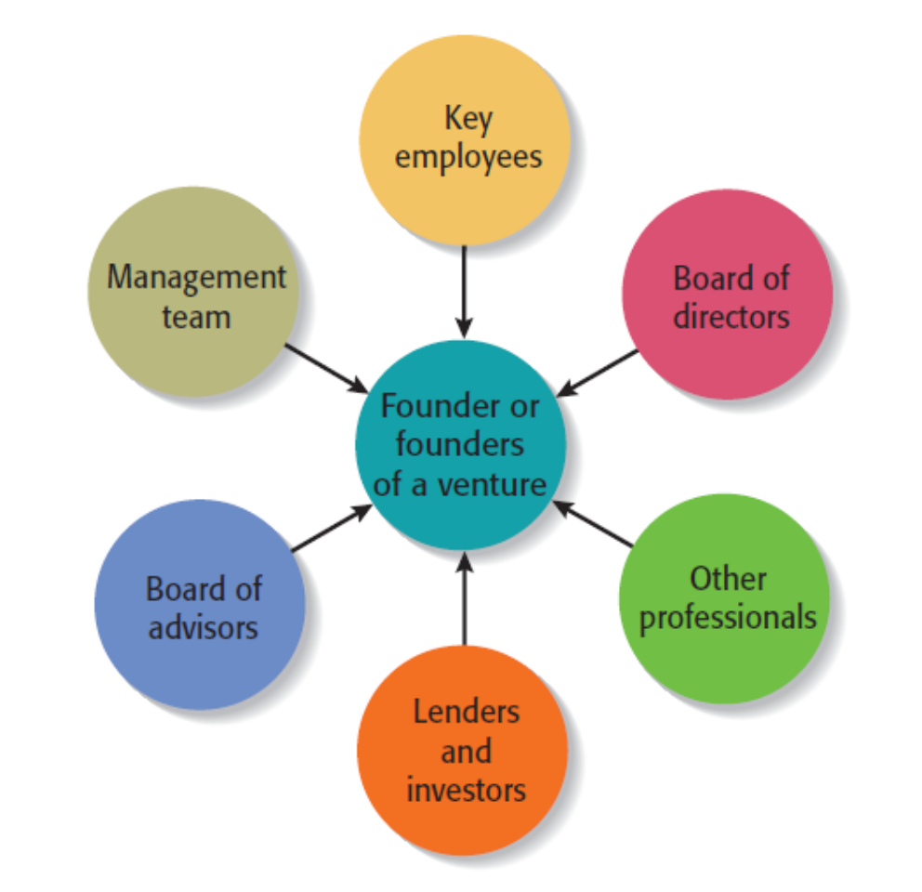
Separate Elements of a New-Venture Team
Copyright ©2016 Pearson Education, Inc.
9-<number>

Slide 6
The Founder or Founders
Founder or Founders
  The characteristics of the founder or founders of a firm and their early decisions have a significant impact on the manner in which the new-venture team takes shape.
Size of the Founding Team
  Studies have shown that 50% to 70% of all new ventures are started by more than one individual.
  Experts disagree about whether new ventures started by a team have an advantage over those started by a sole entrepreneur.
Copyright ©2016 Pearson Education, Inc.
9-<number>

Slide 7
Advantages and Disadvantages of Starting a Venture as a Team
1 of 2
Advantages
  Teams bring more talent, resources, and ideas to a new venture.
  Teams bring a broader and deeper network of social and professional contacts to a new business.
  The psychological support that the cofounders of a business can offer one another can be an important element of a new venture’s success.
Copyright ©2016 Pearson Education, Inc.
9-<number>

Slide 8
Advantages and Disadvantages of Starting a Venture as a Team
2 of 2
Disadvantages
  Team members may not get along.
  If two or more people start a firm as “equals,” conflicts can arise when the firm needs to establish a formal structure and designate one person as the CEO.
  If the founders have similar areas of expertise, they may duplicate rather than complement one another.
  Team members can easily disagree in terms of work habits, tolerances for risk, levels of passion for the business, ideas on how the business should be run, and similar key issues.
Copyright ©2016 Pearson Education, Inc.
9-<number>

Slide 9

Key Elements of a Successful
Founding Team
Heterogeneous rather than
homogenous teams tend to be more
effective.
This team is starting an educational
software company.
The young man on the far left is a
former teacher, the man seated is a
software engineer, the woman is a
former middle-school vice-principal,
and the man at the right is a graphic
designer.
Copyright ©2016 Pearson Education, Inc.
9-<number>

Slide 10
Preferred Attributes of Sole Entrepreneurs and Members of a New-Venture Team
1 of 2
Higher Education
  Evidence suggest that important entrepreneurial skills are enhanced through higher education.
Prior Entrepreneurial Experience
  Founders familiar with the entrepreneurial process are more likely to avoid costly mistakes than founders without similar experience.
Copyright ©2016 Pearson Education, Inc.
9-<number>

Slide 11
Preferred Attributes of Sole Entrepreneurs and Members of a New-Venture Team
2 of 2
Relevant Industry Experience
  Founders with relevant industry experience are more likely to have:
    Better established professional networks.
    More applicable marketing and management skills.
Broad Social and Professional Network
  Founders with broad social and professional networks have potential access to additional know-how, capital, and customer referrals.
Copyright ©2016 Pearson Education, Inc.
9-<number>

Slide 12
Recruiting and Selecting Key Employees
Recruiting Key Employees
  Start-ups vary in terms of how quickly they need to add personnel.
  In some instances, the founders will work alone for a period of time. In other instances, employees are hired immediately.
  A skills profile is a chart that depicts the most important skills that are needed and where skills gaps exist in a new firm.
Copyright ©2016 Pearson Education, Inc.
9-<number>

Slide 13
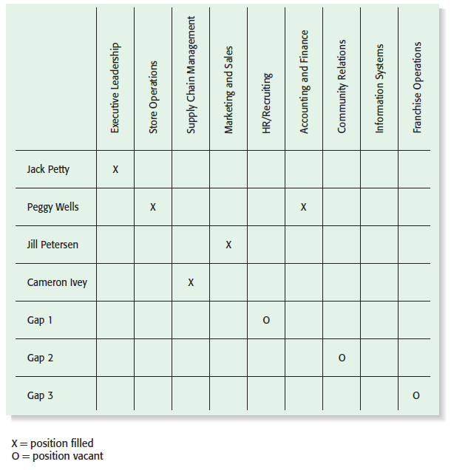
Skills Profile for New Venture Fitness Drinks
Copyright ©2016 Pearson Education, Inc.
9-<number>

Slide 14
Sources of Labor New Ventures Utilize
1 of 2
Full or Part-time Employee
  Someone who works for a business, at the business’s location, utilizing the business’s tools and equipment and according to the business’s policies and procedures.
Intern
  An intern is a person who works for a business as an apprentice or trainee for the purpose of obtaining practical experience.
Copyright ©2016 Pearson Education, Inc.
9-<number>

Slide 15
Sources of Labor New Ventures Utilize
2 of 2
Freelancer (or contractor)
  A person who is in business for themselves, works on their own time with their own tools and equipment, and performs services for a number of different clients.
Virtual Assistant
  A freelancer who provides administrative, technical, or creative assistance to clients remotely from a home office.
Copyright ©2016 Pearson Education, Inc.
9-<number>

Slide 16
The Roles of the Board of Directors
1 of 2
Board of Directors
  If a new venture organizes as a corporation, it is legally required to have a board of directors.
  A board of directors is a panel of individuals who are elected by a corporation’s shareholders to oversee the management of the firm.
  A board is typically made up of both inside directors and outside directors.
    An inside director is a person who is also an officer of the firm.
    An outside director is someone who is not employed by the firm.
Copyright ©2016 Pearson Education, Inc.
9-<number>

Slide 17
The Roles of the Board of Directors
2 of 2
Formal Responsibility of the Board
  A board of directors has three formal responsibilities.
    Appoint the officers of the firm.
    Declare dividends.
    Oversee the affairs of the corporation.
Frequency of Meetings and Compensation
  Most boards of directors meet three to four times a year.
  New ventures are more likely to pay their board members in company stock or ask them to serve on a voluntary basis rather than pay a cash honorarium.
Copyright ©2016 Pearson Education, Inc.
9-<number>

Slide 18
What a Board of Directors Can Do to Help a Start-Up Get Off to a Good Start
Function
Importance of Function
Although a board of directors has formal governance responsibilities, its most useful role is to provide guidance and support to the firm’s managers.
Provide Guidance
Another function of a board of directors is to lend legitimacy to a firm. Well-known and respected board members bring instant credibility to a firm.
Lend Legitimacy
Copyright ©2016 Pearson Education, Inc.
9-<number>

Slide 19
Rounding out the Team: The Role of Professional Advisors
Board of Advisors
Lenders and Investors
Other Professionals
Copyright ©2016 Pearson Education, Inc.
9-<number>

Slide 20
Board of Advisors
1 of 3
Board of Advisors
  A board of advisors is a panel of experts who are asked by a firm’s managers to provide counsel and advice on an ongoing basis.
  Unlike a board of directors, an advisory board possesses no legal responsibility for the firm and gives nonbinding advice.
  An advisory board can be established for general purposes or can be set up to address a specific issue or need.
Copyright ©2016 Pearson Education, Inc.
9-<number>

Slide 21
Board of Advisors
2 of 3
Board of Advisors (continued)
  Many people are more willing to serve on a company’s board of advisors than its board of directors because it requires less time and there is no potential legal liability involved.
  Like the members of a board of directors, the members of a company’s board of advisors provide guidance and lend credibility to the firm.
Copyright ©2016 Pearson Education, Inc.
9-<number>

Slide 22
Board of Advisors
3 of 3
Guidelines to Organizing a Board of Advisors
  Advisors will become disillusioned if they don’t play a meaningful role in the firm’s development and growth.
  A firm should look for board members who are compatible and complement one another in terms of experience and expertise.
  When inviting people to serve on its board of advisors, a company should carefully spell out to the individuals involved the rules in terms of access to confidential information.
Copyright ©2016 Pearson Education, Inc.
9-<number>

Slide 23
Lenders and Investors
Lenders and Investors
  Lenders and investors have a vested interest in the companies they finance, often causing them to become very involved in helping the firms they fund.
  Like the other non-employee members of a firm’s new-venture team, lenders and investors help new firms by providing guidance and lending advice.
  In addition, a firm’s lenders and investors assume the natural role of providing financial oversight.
Copyright ©2016 Pearson Education, Inc.
9-<number>

Slide 24
Ways Lenders and Investors Add Value to an Entrepreneurial Firm
1 of 2
Provide insight into the markets that the new venture plans to enter.
Help identify and recruit key management personnel.
Help the venture fine-tune its business model.
Serve as a sounding board for new ideas.
Serve on the new venture’s board of directors or board of advisors.
Provide introductions to additional sources of capital.
Copyright ©2016 Pearson Education, Inc.
9-<number>

Slide 25
Ways Lenders and Investors Add Value to an Entrepreneurial Firm
2 of 2
Help to arrange business partnerships
Recruit customers
Provide a sense of stability and calm
Copyright ©2016 Pearson Education, Inc.
9-<number>

Slide 26
Other Professionals
Other Professionals
  The other professionals that make up a firm’s new-venture team include attorneys, accountants, and business consultants.
Business Consultants
  A business consultant is an individual who gives professional or expert advice.
  Business consultants fall into two categories: paid consultants and consultants who are available for free or at a reduced rate through a nonprofit or governmental agency.
Copyright ©2016 Pearson Education, Inc.
9-<number>

Slide 27

Copyright ©2016 Pearson Education, Inc.
9-<number>

